Slide 1
MFIFB: Multi-focus Image Fusion Benchmark

Slide 2
catalog
Overview of Image Fusion
MFIFB: Multi-focus Image Fusion Benchmark
Self-built dataset
Fusion Methods and Results
Evaluation Metrics
Evaluation of Methods

Slide 3
Overview of Image Fusion

Slide 4
Image fusion
Image fusion is a technique that produces a single image by combining multiple images from multiple sensors or the same sensor.
Multi-Modal Image Fusion
Infrared and Visible Image Fusion
Medical Image Fusion
Digital Photography Image Fusion
Multi-exposure Image Fusion
Multi-focus Image Fusion
Remote Sensing Image Fusion
Pansharpening
Decision-level fusion: Fusion at a higher level of abstraction.
Pixel-level fusion: Directly processes the pixel values of the source image.
Feature-level fusion: Extracting and fusing image features.

Slide 5
Multi-focus image fusion
Methods | Title | Foundational Framework | Supervisory Paradigm
CNN | Multi-focus image fusion with a deep convolutional neural network | CNN | supervised
ECNN | Ensemble of CNN for multi-focus image fusion | CNN | supervised
MLFCNN | Multilevel features convolutional neural network for multifocus image fusion | CNN | supervised
DRPL | DRPL: Deep Regression Pair Learning for Multi-Focus Image Fusion | CNN | supervised
MMF-Net | An α-Matte Boundary Defocus Model-Based Cascaded Network for Multi-Focus Image Fusion | CNN | supervised
MFF-SSIM | Towards Reducing Severe Defocus Spread Effects for Multi-Focus Image Fusion via an Optimization Based Strategy | CNN | Without supervision
MFNet | Structural Similarity Loss for Learning to Fuse Multi-Focus Images | CNN | supervised

Slide 6
Multi-focus image fusion
Methods | Title | Foundational Framework | Supervisory Paradigm
GEU-Net | Global-Feature Encoding U-Net (GEU-Net) for Multi-Focus Image Fusion [GEU-Net | CNN | Self-supervised
DTMNet | DTMNet: A Discrete Tchebichef Moments-Based Deep Neural Network for Multi-Focus Image Fusion | CNN | Without supervision
MFF-GAN | MFF-GAN: An unsupervised generative adversarial network with adaptive and gradient joint constraints for multi-focus image fusion | GAN | Without supervision
SMFuse | SMFuse: Multi-Focus Image Fusion Via Self-Supervised Mask-Optimization | CNN | Without supervision
ACGAN | A generative adversarial network with adaptive constraints for multi-focus image fusion | GAN | supervised
FuseGAN | Learning to fuse multi-focus image via conditional generative adversarial network | GAN | supervised
D2FMIF | Depth-Distilled Multi-focus Image Fusion | CNN | supervised

Slide 7
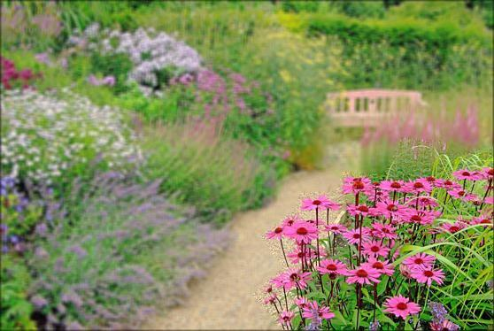
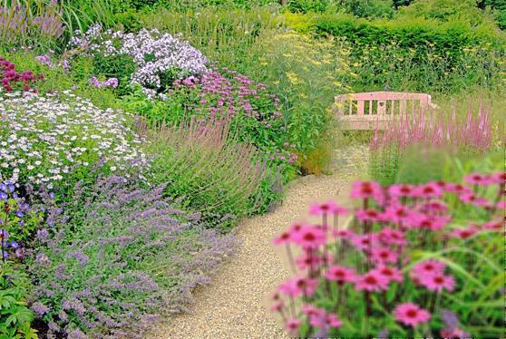

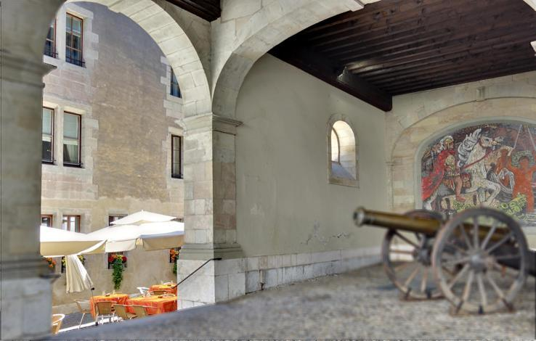
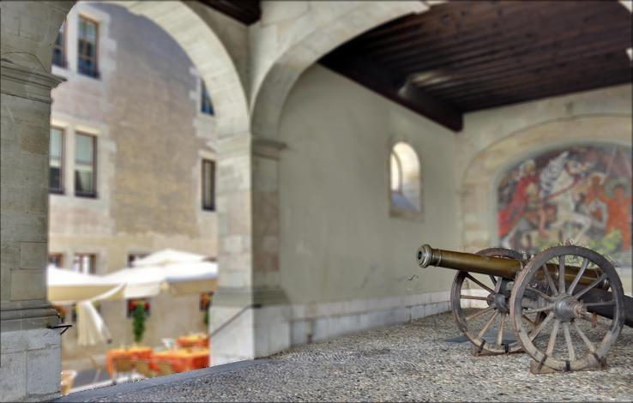

Multi-focus image fusion
original image A
original image B
fusion image
original image A
original image B
fusion image

Slide 8
MFIFB: Multi-focus Image Fusion Benchmark

Slide 9
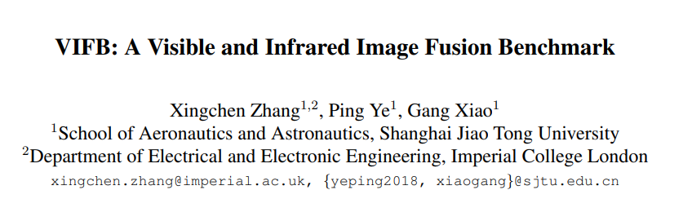
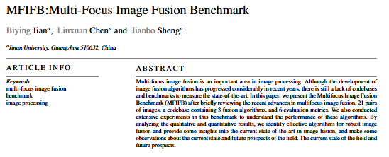
Proposal of MFIFB
We reviewed the paper "VIFB: A Visible and Infrared Image Fusion Benchmark", which highlights the benefits of combining infrared and visible images. While VIFB provides a benchmark for these types, the multi-focus image fusion area lacks comprehensive benchmarks.
Our research establishes a comprehensive benchmark for multi-focus image fusion, enhancing evaluation and algorithm development in the field.
To fill this gap, we propose the Multifocus Image Fusion Benchmark (MFIFB), which includes
40 pairs of images for evaluation.
A codebase with 6 fusion algorithms.
10 evaluation metrics for comprehensive assessment.
(first draft)
Our experiments provide insights into effective algorithms and the current state of the art in image fusion.
We plan to continue expanding the evaluation of cutting-edge algorithms for multi-focus image fusion and enhance the codebase. Our current work tests the feasibility of this idea.

Slide 10
Detailed Research Work Description
Dataset Construction: Developed a custom multi-focus image dataset consisting of 40 sets. Each set includes two original images with different focus areas and one fully focused ground truth image.
Fusion Methods Application: Implemented 6 fusion methods (Curvelet, Gradient, IDWT, Laplacian Pyramid, Max, NSCT) on the dataset.
Evaluation Metrics Selection: Chose 10 evaluation metrics to assess the performance of the fusion methods.
Performance Evaluation: Systematically evaluated and compared the fusion methods using the selected metrics.
Benchmark Establishment: Provided a standardized platform for researchers to evaluate and develop new multi-focus image fusion algorithms.

Slide 11
Self-built dataset

Slide 12
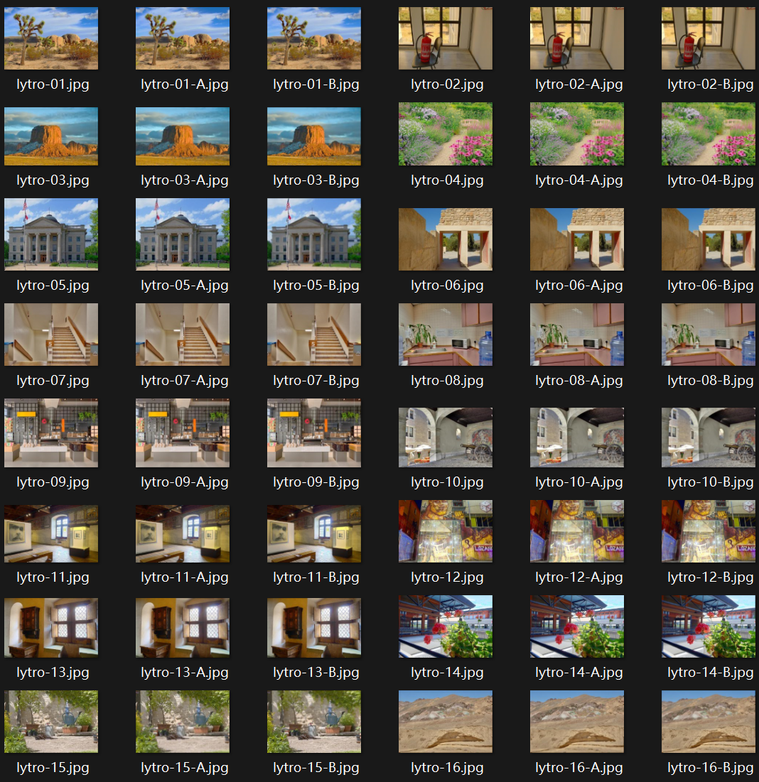
MFIFB Dataset
The MFIFB dataset consists of 40 sets of images. Each set includes:
Two Original Focused Images: Each image in a pair has different focus areas.
One Fused Image: A fully focused image created by fusing the two original images.

Slide 13
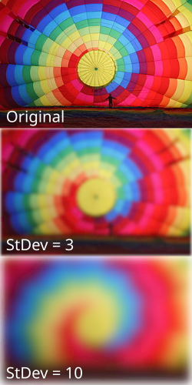
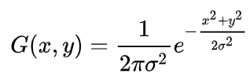
Dataset Construction Steps
Image Collection:
Gather images from the internet.
Ensure diversity by selecting images with different environments and conditions.
Applying Gaussian Blur:
Simulate different focus areas by blurring specific regions of each image.
Select a half region in the image to remain sharp, and apply Gaussian blur to the rest of the image.
Repeat for the second image, focusing on a different region.
Gaussian Blur:
Gaussian blur is an image blur filter that calculates the transform for each pixel in an image using a normal distribution.
Parameters:
Kernel Size: Determines the extent of blurring.
Sigma/StDev: Controls the spread of the blur, higher values result in more blur.

Slide 14
Fusion Methods and Results

Slide 15
Method | Type | Advantages | Disadvantages
Curvelet | Transform Domain | Excels at handling curves and edges | High computational complexity
Gradient | Spatial Domain | Emphasizes edges and details | Sensitive to noise
IDWT | Transform Domain | Preserves multi-resolution details | May cause artifacts
Laplacian Pyramid | Multi-scale Decomposition | Handles features at various scales | Possible detail loss
Max | Simple Pixel-level | Simple and efficient | Possible detail and contrast loss
NSCT | Transform Domain | Good directional selectivity and multi-scale analysis | High computational complexity
Considering factors such as time, technical complexity, and ease of implementation in MATLAB, we selected the 6 fusion methods listed in the table.
The table gives their types, advantages, disadvantages, application scenarios, computational complexity, robustness, and difficulty of implementation.

Slide 16
Method | Computational Complexity | Robustness | Implementation Difficulty | Application Scenarios
Curvelet | High | Moderate | High | Medical image processing
Gradient | Low | Low | Moderate | Natural scene images
IDWT (Inverse Discrete Wavelet Transform) | Moderate | Moderate | Moderate | Natural and medical images
Laplacian Pyramid | Moderate | Moderate | Moderate | Multi-scale image processing
Max | Low | Low | Low | Real-time processing
NSCT (Non-Subsampled Contourlet Transform) | High | High | High | Complex structured images

Slide 17
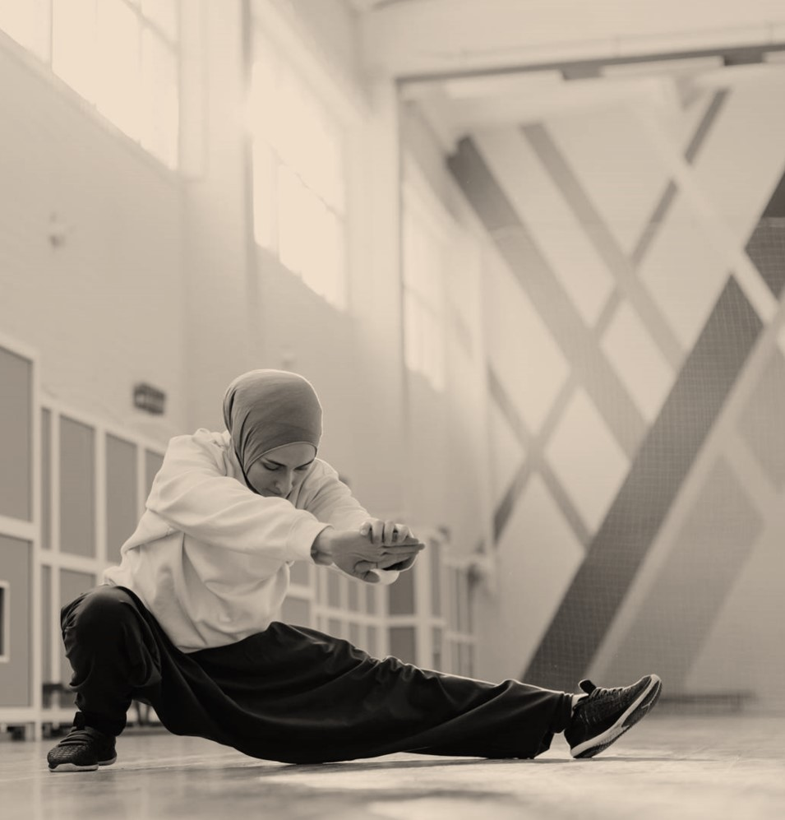
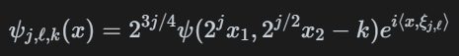
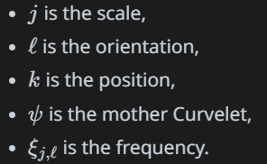
Curvelet
The mathematical representation of the Curvelet transform defined as:
where：
% compute Curvelet transform
C1 = fdct_wrapping(img1, 0, 2, 4, 16);
C2 = fdct_wrapping(img2, 0, 2, 4, 16);
% Initialize the fused Curvelet coefficients
fusedC = C1;
% Fuse each layer
for s = 1:length(C1)
for w = 1:length(C1{s})
% Absolute maximum selection rule
mask = abs(C1{s}{w}) > abs(C2{s}{w});
fusedC{s}{w} = C1{s}{w} .* mask + C2{s}{w} .* ~mask;
end
end

Slide 18
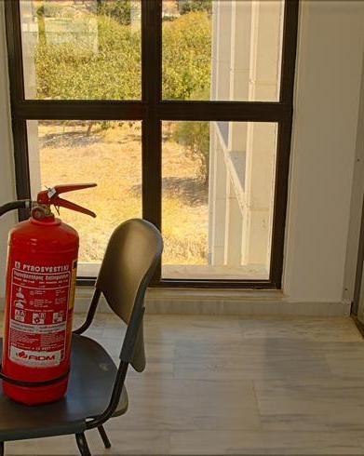
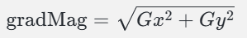
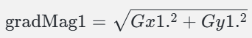
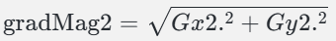
Gradient
The gradient magnitude is calculated to determine the strength of the edges:
Compute Image Gradients:
imgradientxy(img1) and imgradientxy(img2) calculate the gradients in the x and y directions for img1 and img2, resulting in Gx1, Gy1, Gx2, and Gy2.
Calculate Gradient Magnitude:
gradMag1 and gradMag2 are computed using the gradient magnitude formula for each image:
Pixel Selection Using Gradient Magnitude:
A mask is created where the gradient magnitude of img1 is greater than img2: mask = gradMag1 > gradMag2.
% Calculate image gradient
[Gx1, Gy1] = imgradientxy(img1);
[Gx2, Gy2] = imgradientxy(img2);
% Calculate gradient magnitude
gradMag1 = sqrt(Gx1.^2 + Gy1.^2);
gradMag2 = sqrt(Gx2.^2 + Gy2.^2);
% Select pixels using gradient magnitude
mask = gradMag1 > gradMag2;
fused = img1 .* uint8(mask) + img2 .*

Slide 19
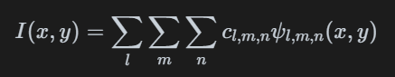
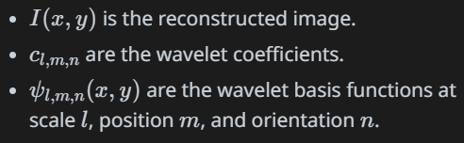
IDWT
% Wavelet decomposition
[cA1, cH1, cV1, cD1] = dwt2(channelA, 'db1');
[cA2, cH2, cV2, cD2] = dwt2(channelB, 'db1');
% Subband fusion rule: choose coefficients with larger absolute values cA = max(cA1, cA2);
cH = max(cH1, cH2);
cV = max(cV1, cV2);
cD = max(cD1, cD2);
% Wavelet reconstruction
fusedChannel = idwt2(cA, cH, cV, cD, 'db1');
% Make sure the size is the same
fusedChannel = imresize(fusedChannel, size(channelA));
The Inverse Discrete Wavelet Transform (IDWT) reconstructs the image from its wavelet coefficients:
where:

Slide 20
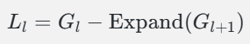
Laplacian Pyramid
% Compute Gaussian pyramid gaussianPyr{1} = img;
for level = 2:numLevels
gaussianPyr{level} = impyramid(gaussianPyr{level-1},
'reduce');
end
% Calculating the Laplace Pyramid
for level = 1:numLevels-1
expanded = impyramid(gaussianPyr{level+1},
'expand');
expanded = imresize(expanded, size(gaussianPyr{level}));
laplacianPyr{level} = gaussianPyr{level} - expanded;
end
Downsampling: Create the Gaussian pyramid by repeatedly applying a Gaussian filter and downsampling the image.
Upsampling and Subtraction: For each level l, compute the Laplacian level by subtracting the expanded version of the next Gaussian level from the current Gaussian level:
Last Level: The last level of the Laplacian pyramid is simply the last level of the Gaussian pyramid.

Slide 21
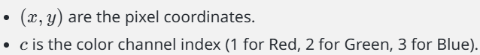
Max
The fusion rule used here is based on the maximum value selection:
Where:
Read Images: imgA and imgB are read from their respective file paths using imread.
Initialize Fused Image: fusedImage is initialized as a zero matrix with the same size and type as imgA.
Fusion for Each Color Channel:
The code iterates over each color channel (assuming RGB, so there are three channels).
For each channel, it applies the max function to select the maximum intensity value for each pixel position between imgA and imgB.
% Read image
imgA = imread(imgAPath);
imgB = imread(imgBPath);
% Initialize the fused image
fusedImage = zeros(size(imgA), 'like', imgA);
% Perform fusion for each color channel
for channel = 1:3
% Fusion rule: select the brighter of each pixel
fusedImage(:,:,channel) = max(imgA(:,:,channel), imgB(:,:,channel));
end

Slide 22
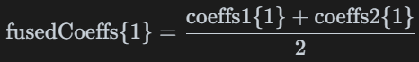
NSCT
% Perform NSCT decomposition
coeffs1 = nsctdec(img1, nlevels,
dfilt, pfilt);
coeffs2 = nsctdec(img2, nlevels,
dfilt, pfilt);
% Initialize fusion coefficients
fusedCoeffs = coeffs1;
% Fuse low frequency subbands
fusedCoeffs{1} = (coeffs1{1} + coeffs2{1}) / 2;
% Fuse high frequency subbands
for i = 2:length(coeffs1)
for j = 1:length(coeffs1{i})
% Use absolute maximum selection rule
mask = abs(coeffs1{i}{j}) > abs(coeffs2{i}{j});
fusedCoeffs{i}{j} = coeffs1{i}{j} .* mask + coeffs2{i}{j} .* ~mask;
end
end
Initialize Fused Coefficients: fusedCoeffs is initialized with the coefficients from img1.
Low-Frequency Sub-band Fusion: The low-frequency sub-band is fused by averaging the coefficients from both images:
High-Frequency Sub-band Fusion:
For each high-frequency sub-band, the absolute maximum selection rule is applied:
The fused coefficients are chosen based on this mask:

Slide 23
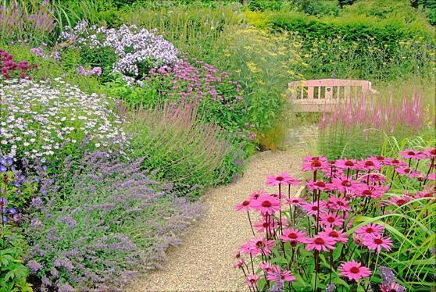
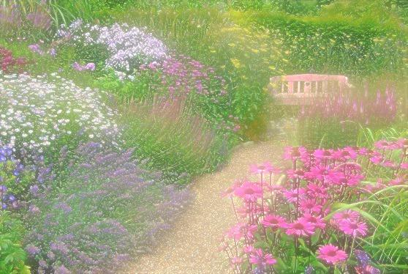
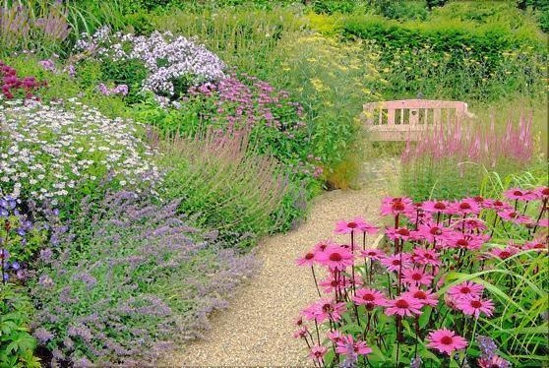
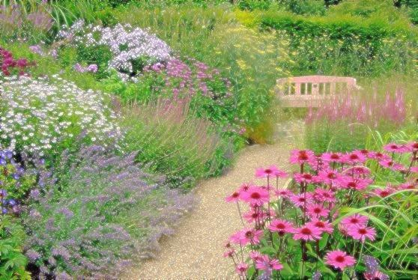
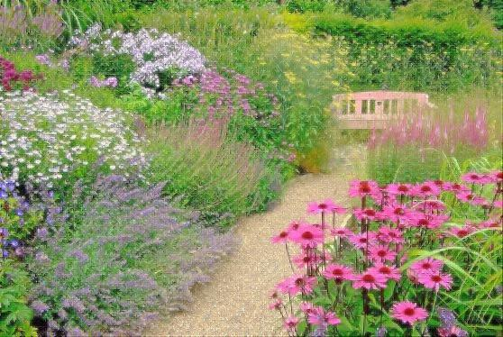
Curvelet
Laplacian Pyramid
original image A
Gradient
Max
original image B
IDWT
NSCT

Slide 24
Evaluation Metrics

Slide 25
Metric | Description | Category
AG | Measures the sharpness of an image by calculating the average gradient. | Sharpness
CC | Evaluates the degree of correlation between two images. | Similarity
Hab | Assesses the suitability of an image for certain applications. | Application Suitability
MSE | Quantifies the difference between values implied by an estimator and the true values. | Error Measurement
PSNR | Measures the peak error between two images, indicating quality. | Quality Assessment
To evaluate multifocal image fusion, metrics are typically divided into four categories: information theory-based, image feature-based, image structure similarity-based, and human perception-based.

Slide 26
Each category offers unique insights, but no single metric is superior in all aspects.
Therefore, we implemented 10 different metrics in MATLAB to ensure a comprehensive and objective performance comparison.
Metric | Description | Category
QCB | Evaluates the quality components of an image. | Quality Assessment
QG | Measures the quality of an image based on gradient analysis. | Quality Assessment
QP | Assesses perceived quality by human observers. | Application Suitability
SD | Quantifies the difference between values implied by an estimator and the true values. | Perception
VIF | Indicates the amount of variation or dispersion in an image. | Statistical Measurement

Slide 27
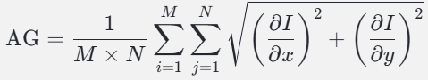
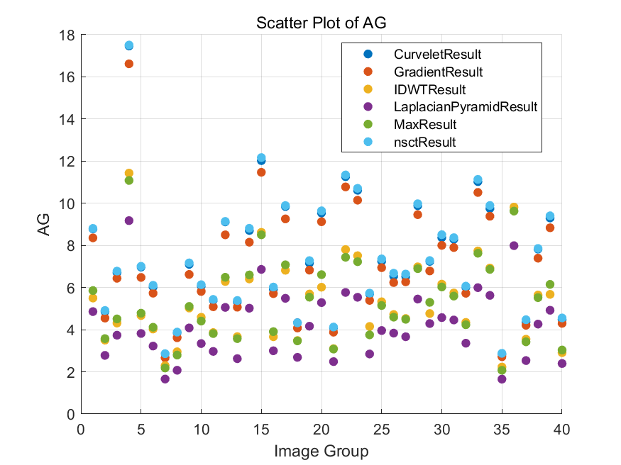
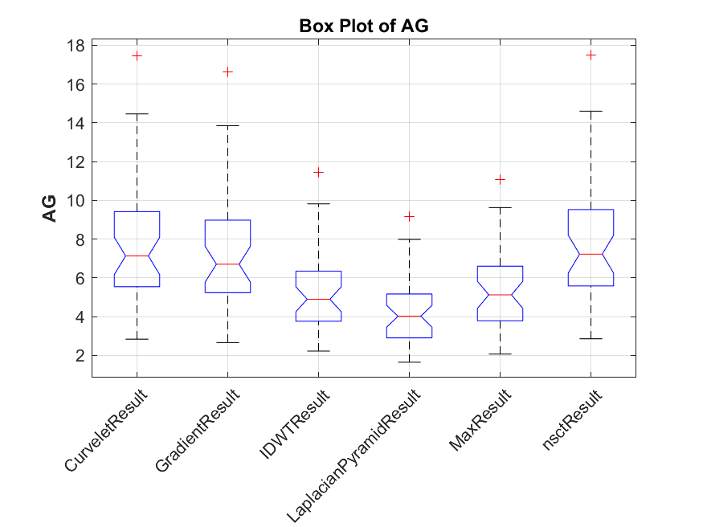
Average Gradient (AG)
AG evaluates the sharpness of the fused image by calculating the average change in intensity.

Slide 28
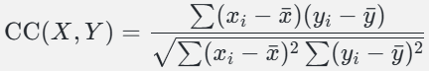
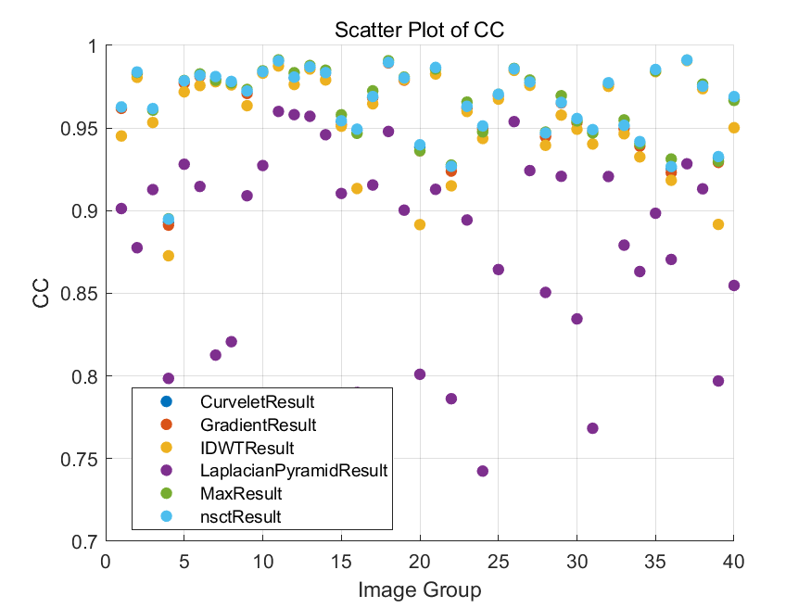
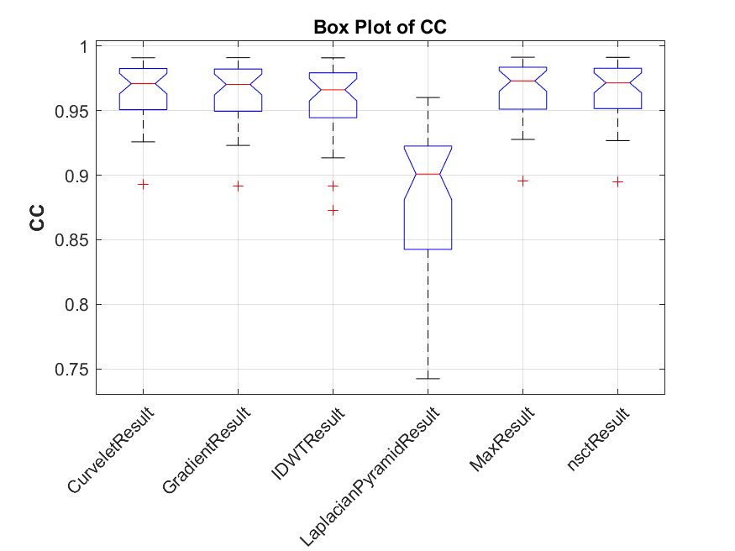
Correlation Coefficient (CC)
The Correlation Coefficient measures the linear relationship between the fused image and the source images. A higher CC indicates a stronger correlation, meaning the fused image retains more information from the source images.

Slide 29
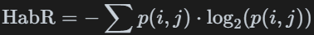
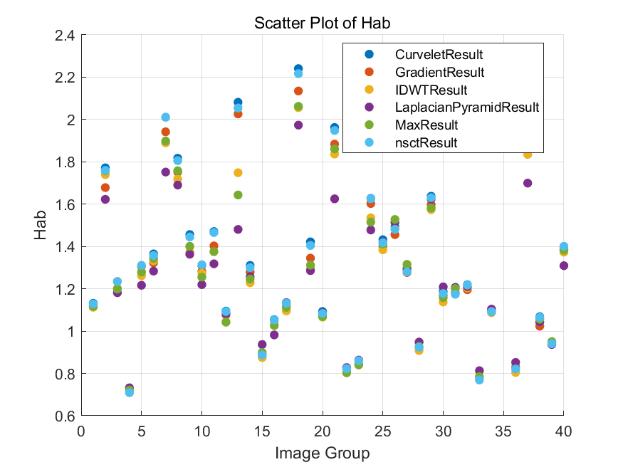
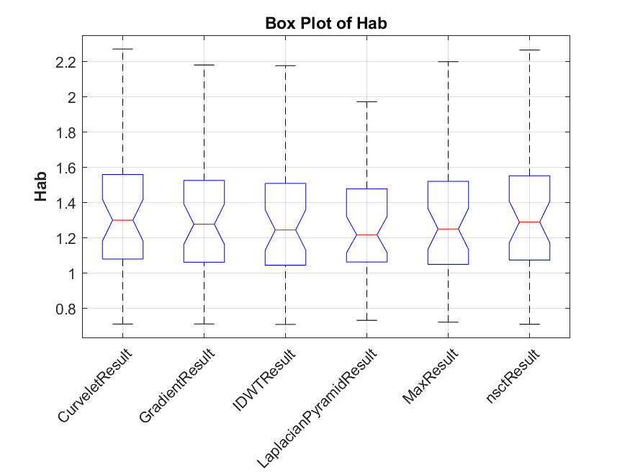
Hab Metric Explanation
The Hab metric is used to compute the mutual information between two images, which can help assess the amount of shared information between them.
Joint Histogram Calculation
Joint Entropy Calculation: Compute the joint entropy using:
where p(i,j) is the normalized joint probability of grayscale values i and j.

Slide 30
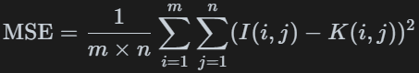
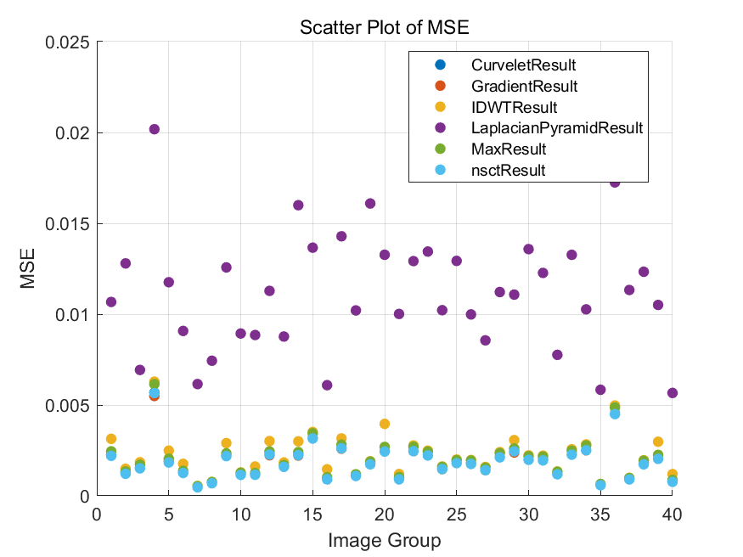
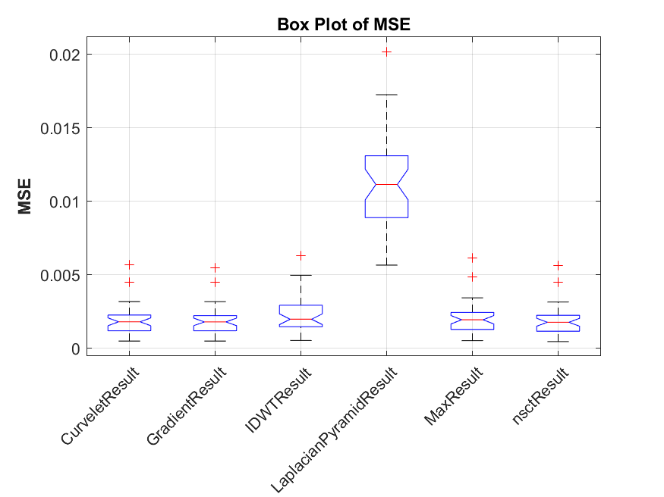
Mean Squared Error (MSE)
MSE is a metric used to measure the average squared difference between the pixel values of two images. It is commonly used to evaluate the quality of image reconstruction or fusion by comparing the original and processed images.
Calculation Formula

Slide 31
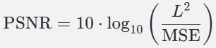
Peak Signal-to-Noise Ratio (PSNR)
PSNR is a metric used to evaluate the quality of a processed image compared to the original image. It is expressed in decibels (dB) and is commonly used in image compression and fusion.

Slide 32
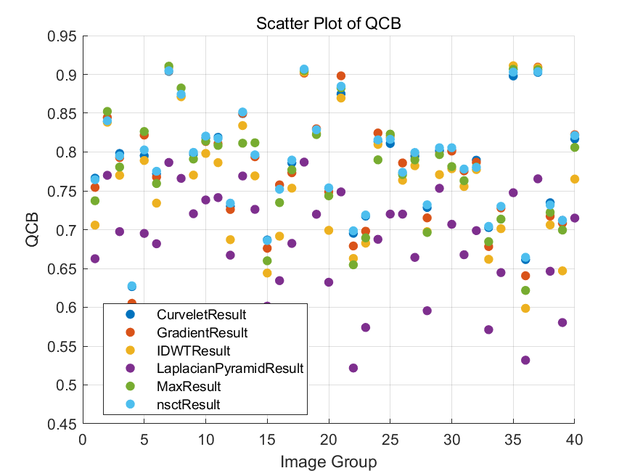
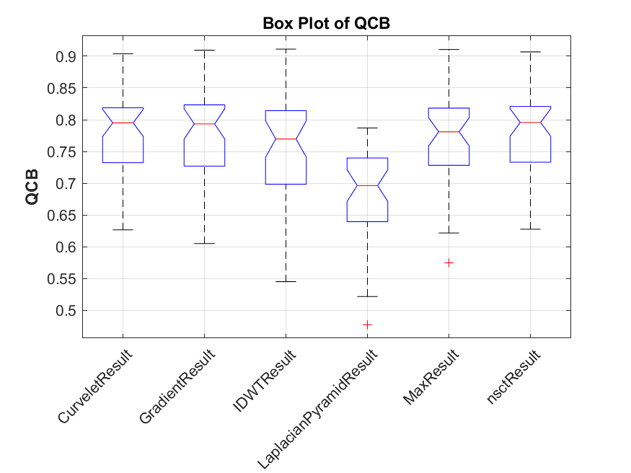
Quality Composite Evaluation (QCB)
QCB is a composite metric used to evaluate the overall quality of an image by combining various quality aspects.

Slide 33
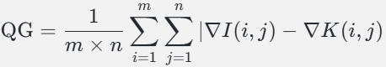
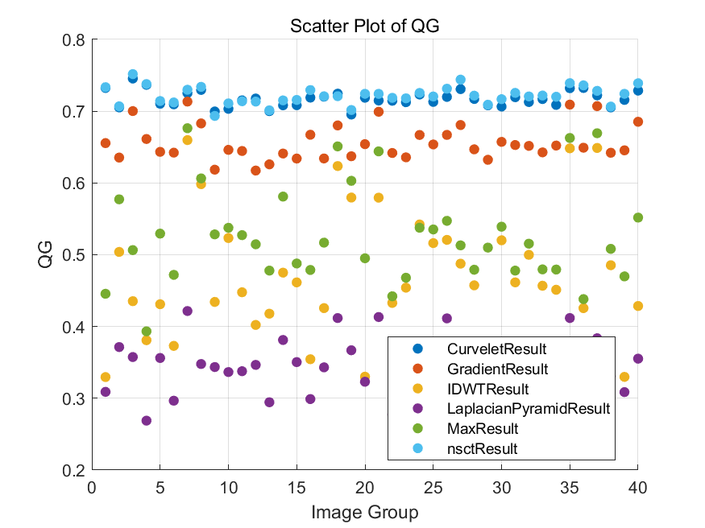
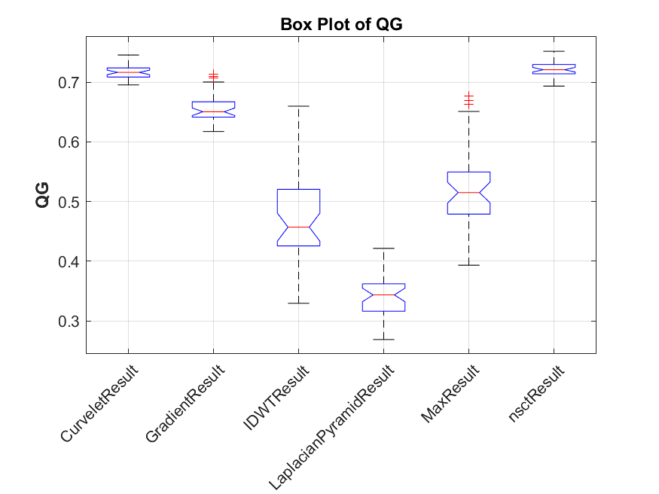
Gradient Quality Evaluation (QG)
QG is a metric used to assess the quality of an image based on its gradient information. It focuses on evaluating the preservation of edges and details, which are crucial for image clarity.

Slide 34
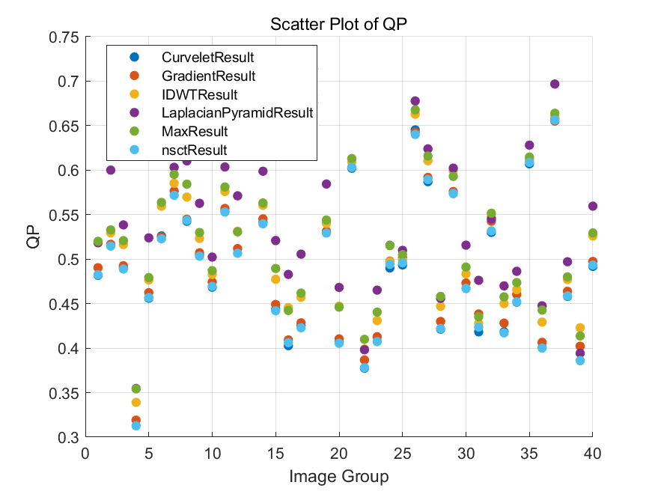
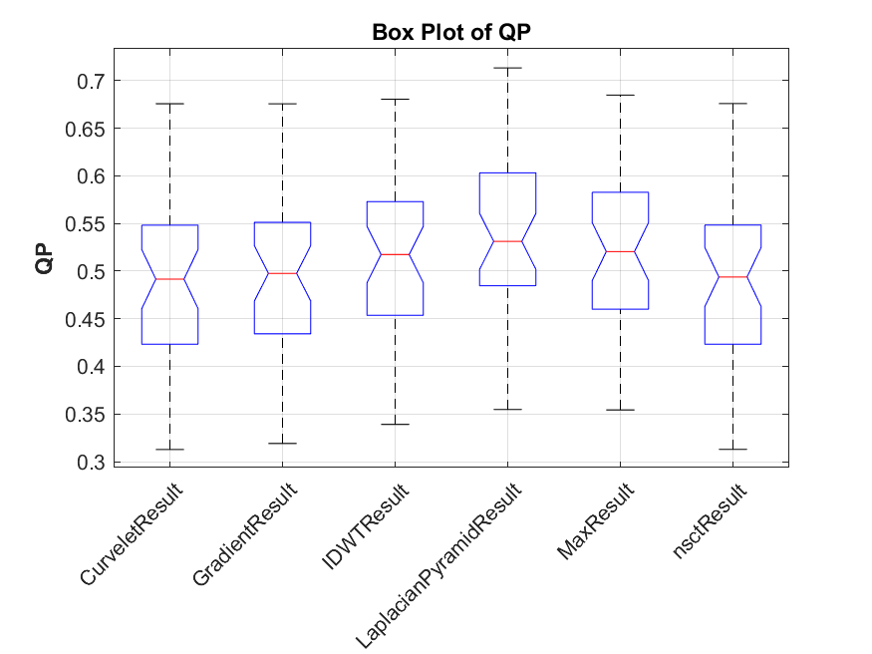
Perceived Quality (QP)
QP is a metric designed to assess the perceived visual quality of an image. It aims to reflect human perception by evaluating aspects that contribute to how an image is viewed subjectively.

Slide 35
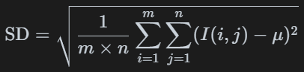
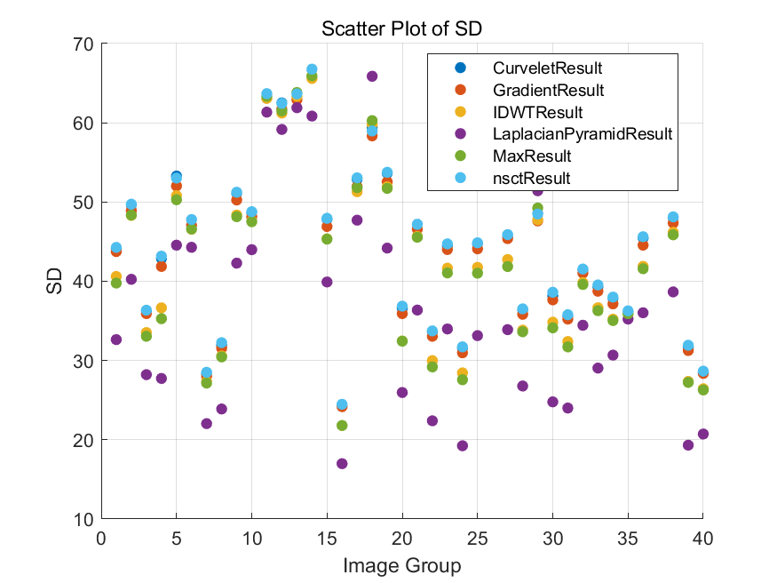
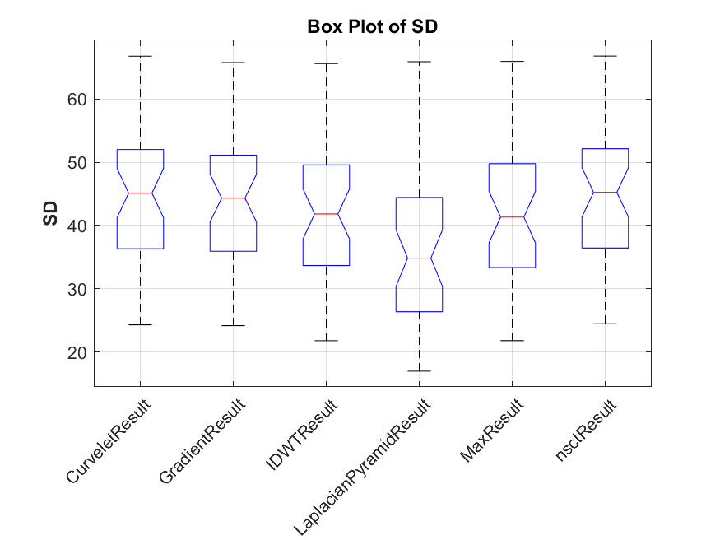
Structural Dissimilarity(SD)
The standard deviation in the context of image processing is a statistical measure used to quantify the amount of variation or dispersion in the pixel intensity values of an image. It provides insight into the contrast and texture of the image.

Slide 36
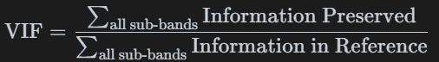


Visual Information Fidelity (VIF)
VIF is a metric that quantifies the amount of visual information preserved in a distorted image compared to a reference image. It is based on natural scene statistics and models the human visual system to assess image quality.

Slide 37
Evaluation of Methods

Slide 38
AG
MSE
QG
The CurveletResult method shows the highest median AG, indicating better sharpness and detail preservation.
GradientResult and LaplacianPyramidResult also perform well, but with more variability.
LaplacianPyramidResult has the lowest MSE, suggesting it preserves the image content with minimal error.
CurveletResult and IDWTResult also have low MSE values.
nsctResult shows the highest median QG, indicating good gradient quality.
CurveletResult and IDWTResult also perform well in maintaining gradient quality.

Slide 39

CC
PSNR
QP
High CC values are observed across all methods, with CurveletResult and GradientResult having slightly higher medians, indicating strong similarity to the reference images.
LaplacianPyramidResult and IDWTResult have the highest PSNR values, suggesting better overall image quality.
MaxResult shows lower PSNR, indicating more noise or distortion.
The nsctResult and CurveletResult methods have higher perceived quality scores, reflecting better visual fidelity.

Slide 40
Hab
QCB
SD
AG
Results are fairly similar across methods, with CurveletResult showing a slightly better performance.
CurveletResult and IDWTResult perform well, indicating good composite quality.
All methods show similar SD values, suggesting consistent contrast across methods.
CurveletResult and nsctResult provide higher contrast, which might be beneficial for applications requiring pronounced image features.

Slide 41
Resul | Evaluation
CurveletResult | Excels in preserving image sharpness and quality. Shows minimal error and strong similarity to original images.
IDWTResult | Maintains high image quality with low distortion. Effective in preserving details and gradients.
nsctResult | Offers excellent gradient and visual quality. Ideal for applications needing high perceived fidelity.
LaplacianPyramidResult | Minimizes errors and maintains good image quality. Reliable for general fusion tasks.
GradientResult | Good at preserving details and similarity to originals. Suitable for tasks focusing on sharpness.
MaxResult | Simpler and efficient, but with lower quality. Best for quick, less complex tasks.
Overall, CurveletResult and IDWTResult emerge as top performers, offering a balanced combination of high detail preservation, minimal distortion, and strong visual quality. nsctResult is particularly effective for applications requiring high gradient and perceived quality. The choice of method should align with specific application needs, balancing between computational efficiency and desired image quality outcomes.

Slide 42
THANK YOU

